Slide 1
Hypothesis Testing
Attendance
On your phone/laptop, go to:
pollev.com/ryandew580
and answer the two questions.
Today’s code is:
rain
If you don’t have internet access, come see me.
MKTG-212
Professor Ryan Dew

Slide 2
Announcements
If you came in late:
pollev.com/ryandew580
Code: rain
TA-led R Review Session: Monday, February 17th, starting at 5PM, in JMHH F85
DUA on Canvas
Assignment 1 groups due by Friday
Optimizely reading now OPTIONAL, will discuss tomorrow

Slide 3
Course structure
If you came in late:
pollev.com/ryandew580
Code: rain
MARKETING DECISIONS
DATA
How do we turn the data that we’ve gathered into meaningful information?
ANALYSIS
SPECIAL TOPICS

Slide 4
This Week’s Goals
If you came in late:
pollev.com/ryandew580
Code: rain
Given a question, you should be able to:
Identify which hypothesis test to use
Define a null and alternative hypothesis for a specific question
Carry out the test using Excel
Understand the results of the test: what you can and can’t conclude, and potential pitfalls of hypothesis testing
Two important notes:
Our focus is on using these tools, not necessarily on the math
For the exams, points 1, 2, and 4 are the most important

Slide 5
Conceptual Review

Slide 6
Mary Berry’s New Cookbook
How should Mary price her new book?
Her last book retailed for $34.99
This time, she thinks it can sell for more
She surveys 20 random Americans, asking them their willingness-to-pay (WTP)
Mean: 36.5
SD: 8.5
Is this enough information to go ahead with the price raise?

Slide 7
Important Terms
Population: the group you’re interested in
All Americans
Population Parameter: the thing you want to know
Mean WTP
Sample: the people you actually measured (randomly sampled)
20 random Americans
Sample Estimate (also just the Estimate): the thing you want to know computed from the people you actually measured
Estimate of Mean WTP = 36.5

Slide 8
Sampling Variability
The Population

Slide 9
Sampling Variability
The Population
Sample 1: Mean = 36.5

Slide 10
Sampling Variability
The Population
Sample 1: Mean = 36.5
Sample 2: Mean = 41.0

Slide 11
Sampling Variability
The Population
Sample 1: Mean = 36.5
Sample 2: Mean = 41.0
Sample 3: Mean = 40.7

Slide 12
Sampling Variability
The Population
Sample 1: Mean = 36.5
Sample 2: Mean = 41.0
Sample 3: Mean = 40.7
Sample 4: Mean = 43.1

Slide 13
Sampling Variability
The Population
Sample 1: Mean = 36.5
Sample 2: Mean = 41.0
Sample 3: Mean = 40.7
Sample 4: Mean = 43.1
Sample 5: Mean = 39.7

Slide 14
Sampling Variability
The Population
Sample 1: Mean = 36.5
Sample 2: Mean = 41.0
Sample 3: Mean = 40.7
Sample 4: Mean = 43.1
Sample 5: Mean = 39.7
Over repeated random samples, the sample estimate has a distribution!
This is called the Sampling Distribution.

Slide 15
Back to Mary’s Decision
Her last book retailed for $34.99, but this time, she thinks it can sell for more.
Mean = $36.50, but there’s uncertainty
Is there enough evidence to suggest that the true mean WTP is actually higher than $34.99, given that uncertainty?
Hypothesis test: If the true mean WTP were only $34.99, how likely would we be to get a sample estimate of $36.50, or more extreme?

Slide 16
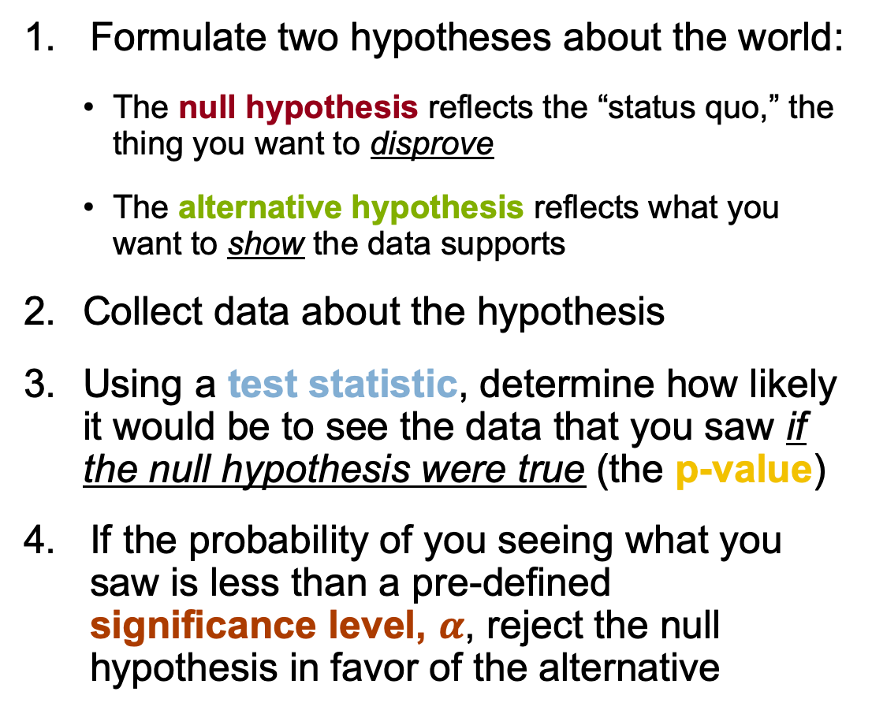
Hypothesis Testing: Four Steps
Mary’s Decision
H₀: Mean WTP = $34.99
H₁: Mean WTP > $34.99
Mean → t-test
$36.50 → t = 0.75
If H₀ true, then the probability of seeing $36.50 (t = 0.75) is P = 0.22
0.22 > 0.05 → Cannot Reject H₀
Formulate two hypotheses about the world:
The null hypothesis reflects the “status quo,” the thing you want to disprove
The alternative hypothesis reflects what you want to show the data supports
Collect data about the hypothesis
Using a test statistic, determine how likely it would be to see the data that you saw if the null hypothesis were true (the p-value)
If the probability of you seeing what you saw is less than a pre-defined significance level, $α$, reject the null hypothesis in favor of the alternative

Slide 17
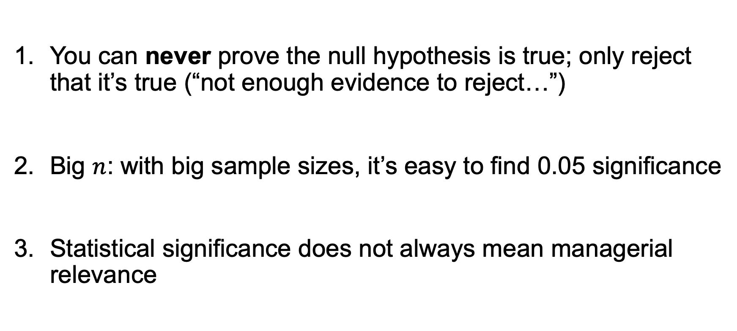
What Can You Conclude: Some Caveats
You can never prove the null hypothesis is true; only reject that it’s true (“not enough evidence to reject…”)
Big $n$: with big sample sizes, it’s easy to find 0.05 significance
Statistical significance does not always mean managerial relevance

Slide 18




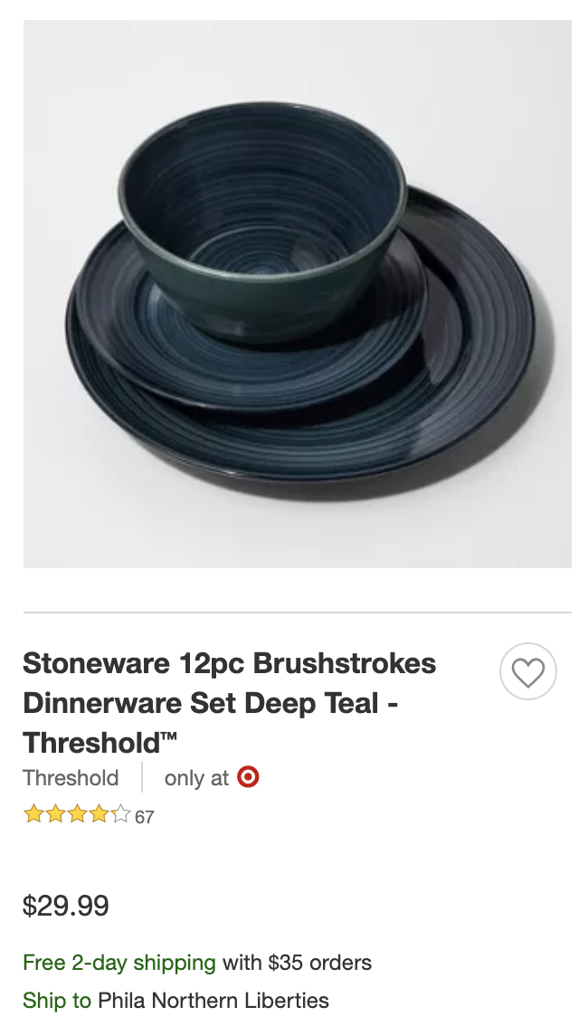

Hypothesis-driven Thinking: Target vs. Walmart
Why do people perceive Walmart as lower-priced than Target?

Slide 19
Testing Means

Slide 20
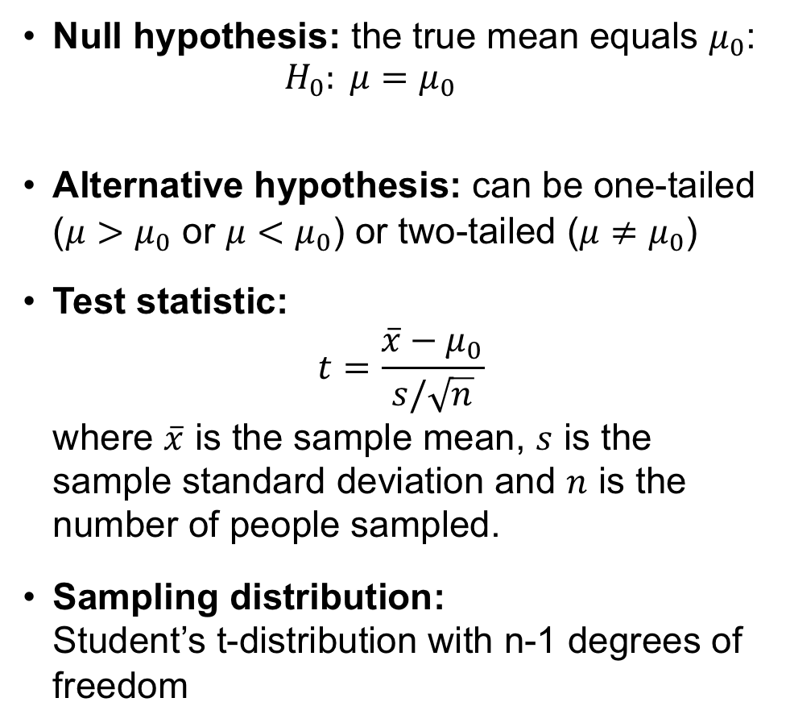
Test for Means: t-test
Null hypothesis: the true mean equals $μ_{0}$:
$$H_{0}: μ=μ_{0}$$
Alternative hypothesis: can be one-tailed ($μ>μ_{0}$ or $μ<μ_{0}$) or two-tailed ($μ≠μ_{0}$)
Test statistic: $t=\frac{\overline{x}−μ_{0}}{s/\sqrt{n}}$ where $\overline{x}$ is the sample mean, $s$ is the sample standard deviation and $n$ is the number of people sampled.
Sampling distribution: Student’s t-distribution with n-1 degrees of freedom
(Truth)
(Hypothesized value)
One-tailed
P-value
t = 0.79

Slide 21
Test for Means: t-test
Null hypothesis: the true mean equals $μ_{0}$:
$$H_{0}: μ=μ_{0}$$
Alternative hypothesis: can be one-tailed ($μ>μ_{0}$ or $μ<μ_{0}$) or two-tailed ($μ≠μ_{0}$)
Test statistic: $t=\frac{\overline{x}−μ_{0}}{s/\sqrt{n}}$ where $\overline{x}$ is the sample mean, $s$ is the sample standard deviation and $n$ is the number of people sampled.
Sampling distribution: Student’s t-distribution with n-1 degrees of freedom
(Truth)
(Hypothesized value)
Two-tailed
P-value
t = -0.79
t = 0.79

Slide 22


An Experiment on Obama’s Website
Obama’s campaign team is testing two landing pages. To that end, they ran an experiment, where 50% of visitors saw one graphic, and 50% saw another. To gather additional information, they then surveyed 200 randomly selected recent donors, and matched their survey responses to their website and donation behavior.
Let’s examine that data in Excel.

Slide 23
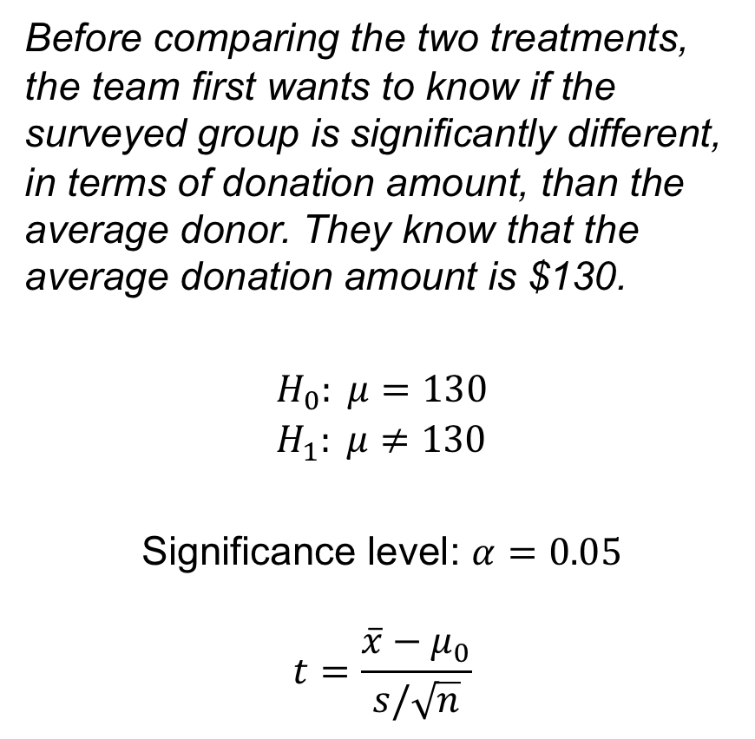
An Experiment on Obama’s Website
Steps to do a hypothesis test
Set the hypotheses, a significance level, and determine the test statistic
Use the data and the null hypothesis to compute the test statistic
Compute the probability of seeing a value more extreme than the test statistic under the sampling distribution (the P-value):
If your alternative is one-sided: take the absolute value of the test statistic and compute the greater than probability
If your alternative is two-sided: multiply the one-sided number by 2.
If P-value < cutoff, reject H₀ in favor of H₁
Before comparing the two treatments, the team first wants to know if the surveyed group is significantly different, in terms of donation amount, than the average donor. They know that the average donation amount is $130.
$$H_{0}: μ=130 \\ H_{1}: μ≠130$$ Significance level: $α=0.05$
$$t=\frac{\overline{x}−μ_{0}}{s/\sqrt{n}}$$
Notes:
COMPUTE THE T-STATISTIC BY ”HAND”
COMPUTE THE COMPONENTS SEPARATELY: N, X-BAR, S, T, P
MAKE SURE TO TAKE TWO-SIDED: 2*(1-T.DIST(STAT, N-1, TRUE))
IN EXCEL, THEY ALSO HAVE T.DIST.2T(STAT, DF) FOR TWO-TAILED TESTS
P = 0.003175

Slide 24
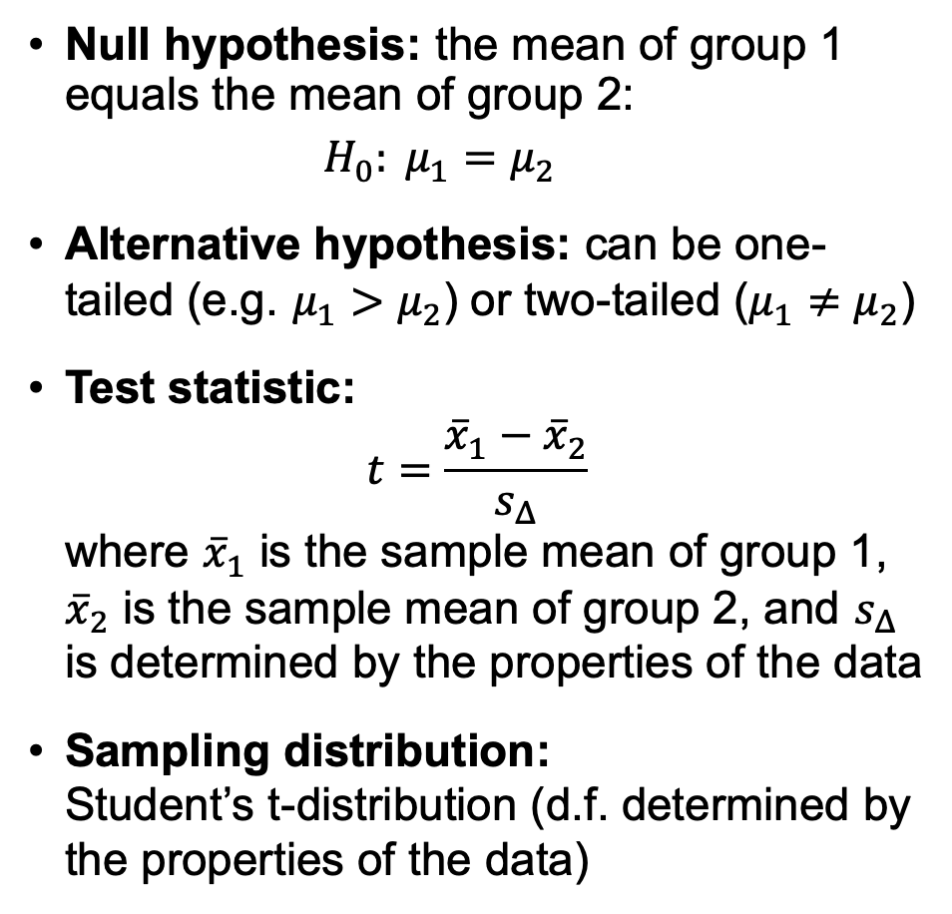
Two Sample t-Test
Null hypothesis: the mean of group 1 equals the mean of group 2:
$$H_{0}: μ_{1}=μ_{2}$$
Alternative hypothesis: can be one-tailed (e.g. $μ_{1}>μ_{2}$) or two-tailed ($μ_{1}≠μ_{2}$)
Test statistic: $t=\frac{{\overline{x}}_{1}−{\overline{x}}_{2}}{s_{Δ}}$ where ${\overline{x}}_{1}$ is the sample mean of group 1, ${\overline{x}}_{2}$ is the sample mean of group 2, and $s_{Δ}$ is determined by the properties of the data
Sampling distribution: Student’s t-distribution (d.f. determined by the properties of the data)
Properties of the data
Is the data paired?
Are the sizes of the groups equal?
Is the variance within each group assumed to be the same?
In terms of test power:
Paired > Equal Size/Variance > Unequal Size/Variance

Slide 25
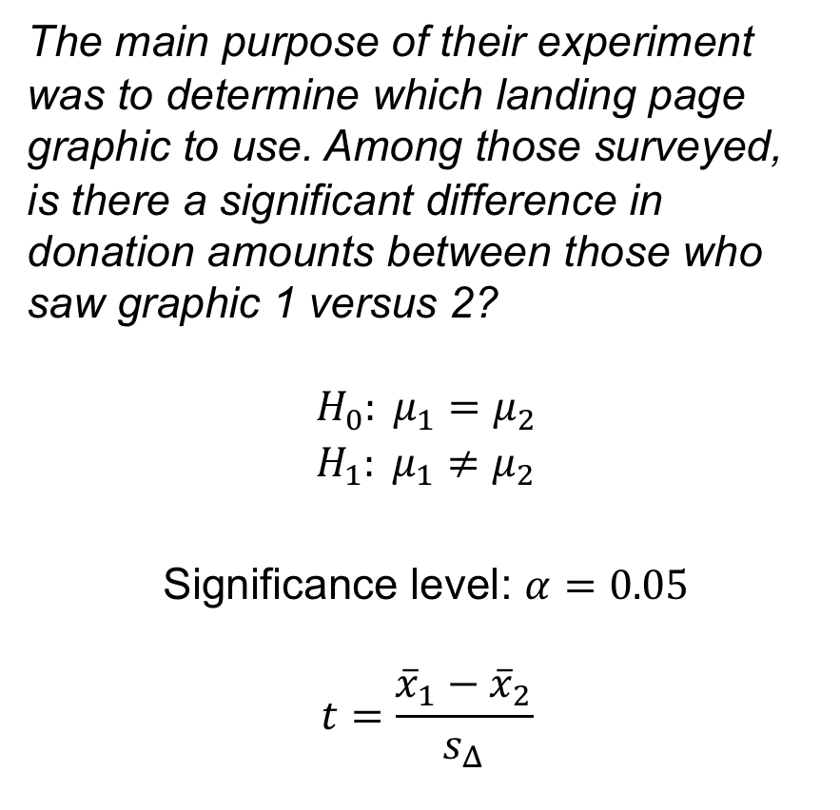
An Experiment on Obama’s Website
Steps to do a hypothesis test
Set the hypotheses, a significance level, and determine the test statistic
Use the data and the null hypothesis to compute the test statistic
Compute the probability of seeing a value more extreme than the test statistic under the sampling distribution (the P-value):
If your alternative is one-sided: take the absolute value of the test statistic and compute the greater than probability
If your alternative is two-sided: multiply the one-sided number by 2.
If P-value < cutoff, reject H₀ in favor of H₁
The main purpose of their experiment was to determine which landing page graphic to use. Among those surveyed, is there a significant difference in donation amounts between those who saw graphic 1 versus 2?
$$H_{0}: μ_{1}=μ_{2} \\ H_{1}: μ_{1}≠μ_{2}$$ Significance level: $α=0.05$
$$t=\frac{{\overline{x}}_{1}−{\overline{x}}_{2}}{s_{Δ}}$$
Notes:
USE DATA ANALYSIS TOOLPAK
IF NOT INSTALLED, CAN GO TO FILE > OPTIONS > ADD-INS > GO > …

Slide 26
Testing Proportions

Slide 27
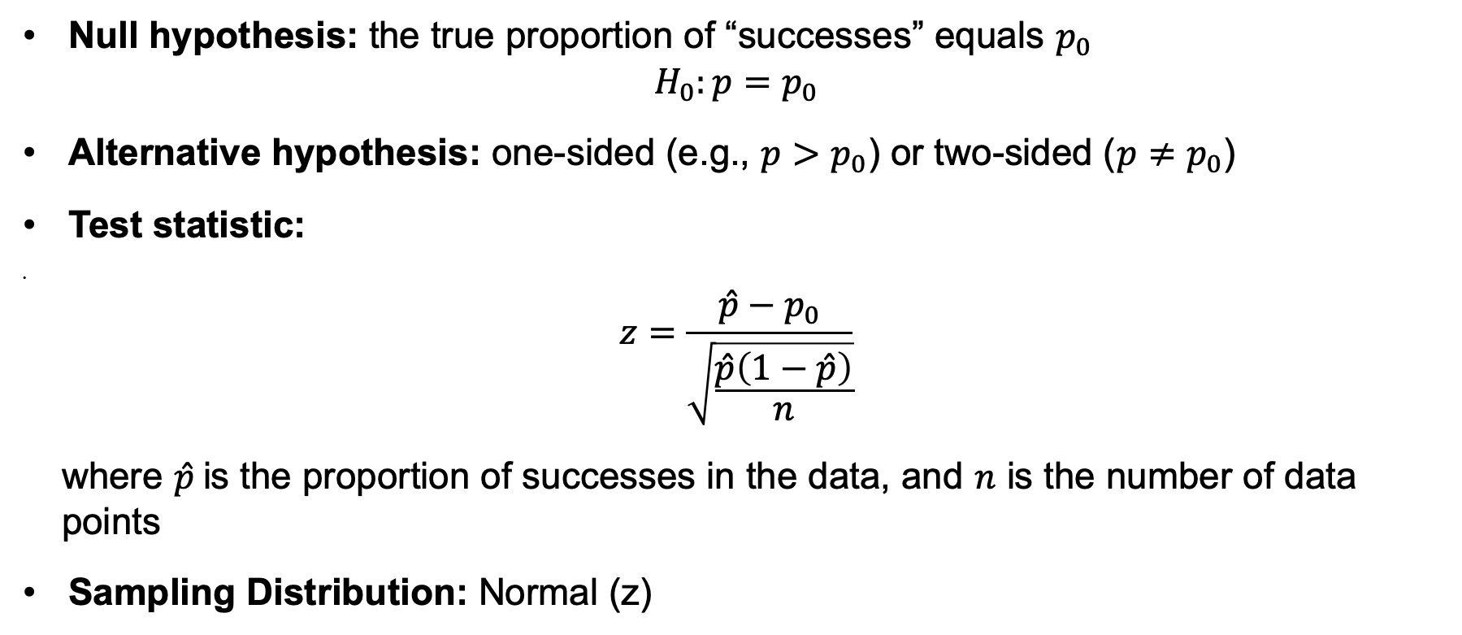
Test #2: z-test for Proportions
Null hypothesis: the true proportion of “successes” equals $p_{0}$ $H_{0}:p=p_{0}$
Alternative hypothesis: one-sided (e.g., $p>p_{0}$) or two-sided ($p≠p_{0}$)
Test statistic:
$z=\frac{\hat{p}−p_{0}}{\sqrt{\frac{\hat{p}\left(1−\hat{p}\right)}{n}}}$
where $\hat{p}$is the proportion of successes in the data, and $n$ is the number of data points
Sampling Distribution: Normal (z)

Slide 28
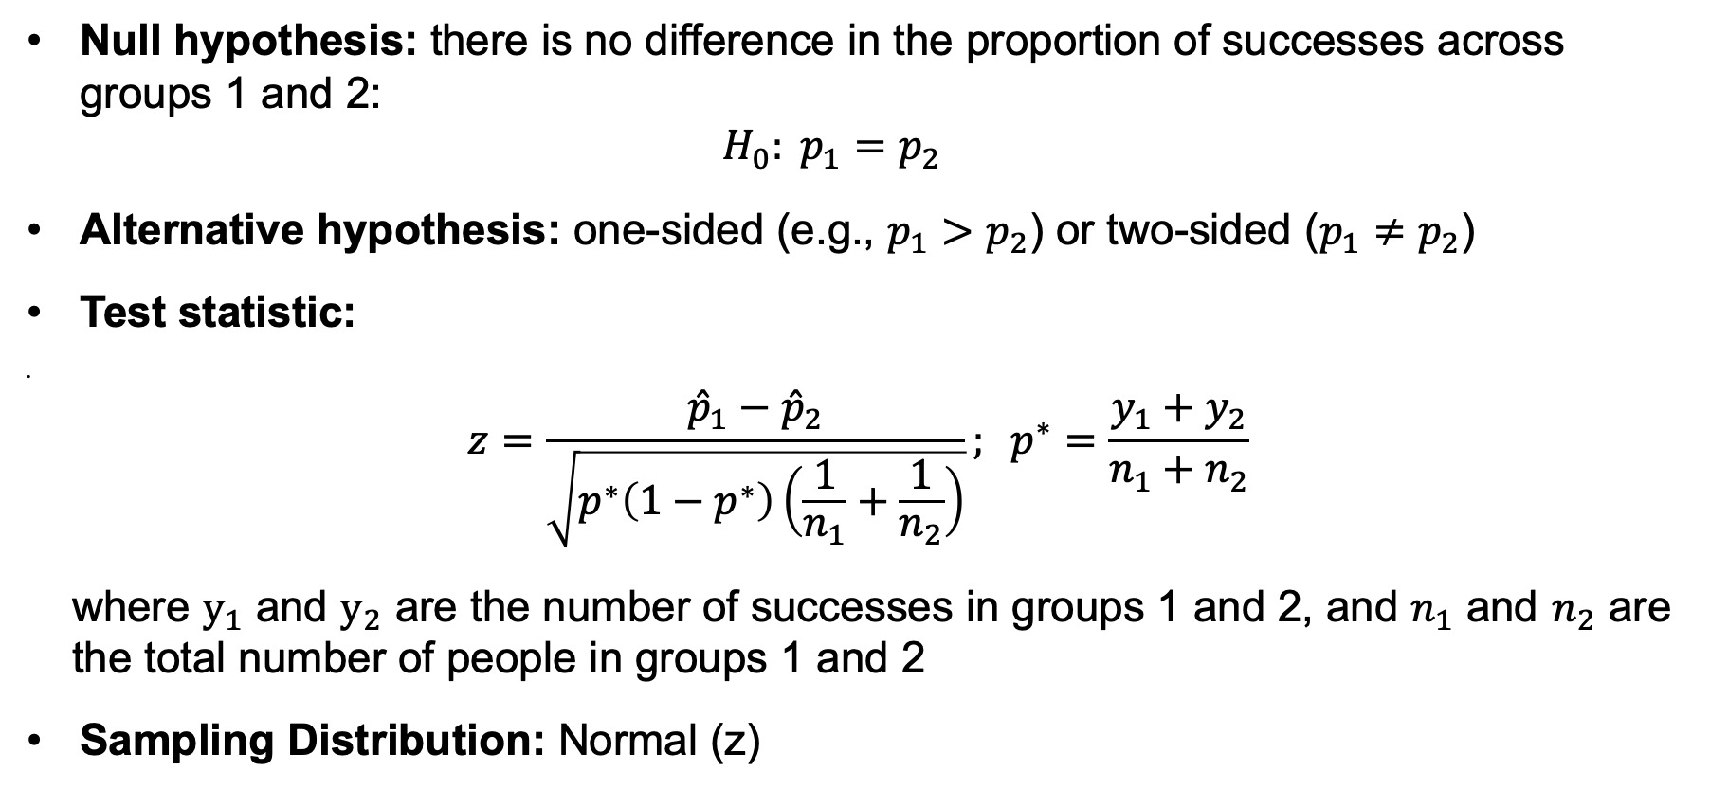
Two-sample z-test for Proportions
Null hypothesis: there is no difference in the proportion of successes across groups 1 and 2: $H_{0}: p_{1}=p_{2}$
Alternative hypothesis: one-sided (e.g., $p_{1}>p_{2}$) or two-sided ($p_{1}≠p_{2}$)
Test statistic:
$z=\frac{{\hat{p}}_{1}−{\hat{p}}_{2}}{\sqrt{p^{∗}\left(1−p^{∗}\right)\left(\frac{1}{n_{1}}+\frac{1}{n_{2}}\right)}}; p^{∗}=\frac{y_{1}+y_{2}}{n_{1}+n_{2}}$
where $y_{1}$ and $y_{2}$ are the number of successes in groups 1 and 2, and $n_{1}$ and $n_{2}$ are the total number of people in groups 1 and 2
Sampling Distribution: Normal (z)

Slide 29
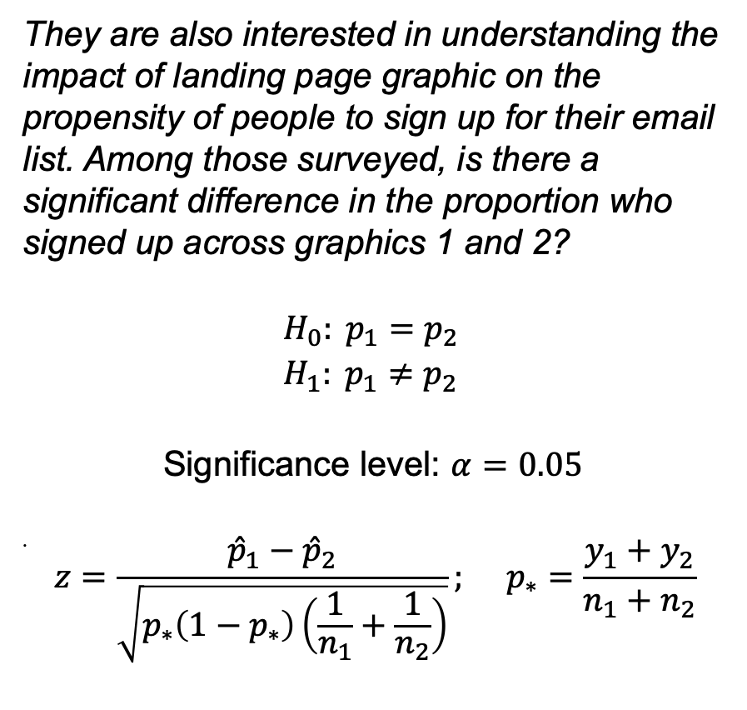
An Experiment on Obama’s Website
Steps to do a hypothesis test
Set the hypotheses, a significance level, and determine the test statistic
Use the data and the null hypothesis to compute the test statistic
Compute the probability of seeing a value more extreme than the test statistic under the sampling distribution (the P-value):
If your alternative is one-sided: take the absolute value of the test statistic and compute the greater than probability
If your alternative is two-sided: multiply the one-sided number by 2.
If P-value < cutoff, reject H₀ in favor of H₁
They are also interested in understanding the impact of landing page graphic on the propensity of people to sign up for their email list. Among those surveyed, is there a significant difference in the proportion who signed up across graphics 1 and 2?
$$H_{0}: p_{1}=p_{2} \\ H_{1}: p_{1}≠p_{2}$$
Significance level: $α=0.05$
$z=\frac{{\hat{p}}_{1}−{\hat{p}}_{2}}{\sqrt{p_{∗}\left(1−p_{∗}\right)\left(\frac{1}{n_{1}}+\frac{1}{n_{2}}\right)}}; p_{∗}=\frac{y_{1}+y_{2}}{n_{1}+n_{2}}$
Notes:
AGAIN COMPUTE BY HAND
PIVOT TABLE
COPY/PASTE AS VALUES
COMPUTE P1, P2, P_STAR, N1, N2
THE EXCEL COMMAND IS NORM.S.DIST FOR THE STANDARD NORMAL DIST
FORMULAA: 2*(1-NORM.S.DIST(Z, TRUE))
P = 0.023624

Slide 30
Testing Distributions

Slide 31
Remember our Example: Obama’s A/B Test
Obama’s campaign team is testing two landing pages. To that end, they ran an experiment, where 50% of visitors saw one graphic, and 50% saw another. To gather additional information, they then surveyed 200 randomly selected recent donors, and matched their survey responses to their website and donation behavior.
Today’s focal question: did the graphic cause people to navigate the website differently?

Slide 32
Contingency Tables
Simple idea: just count (nominal) outcomes!
One-way Table: How many times did each nominal outcome occur?
 | Link A | Link B | Link C | Total
Graphic 1 | 46 | 27 | 27 | 100
Graphic 2 | 26 | 50 | 24 | 100
Total | 72 | 77 | 51 | 200

Slide 33
Contingency Tables
Simple idea: just count (nominal) outcomes!
Two-way Table: How many times did each pair of (nominal) outcomes occur?
 | Link A | Link B | Link C | Total
Graphic 1 | 46 | 27 | 27 | 100
Graphic 2 | 26 | 50 | 24 | 100
Total | 72 | 77 | 51 | 200

Slide 34
Contingency Tables
Simple idea: just count (nominal) outcomes!
Two-way Table: How many times did each pair of (nominal) outcomes occur?
 | Link A | Link B | Link C | Total
Graphic 1 | 46 | 27 | 27 | 100
Graphic 2 | 26 | 50 | 24 | 100
Total | 72 | 77 | 51 | 200
“Cells”

Slide 35
Contingency Tables
Simple idea: just count (nominal) outcomes!
Two-way Table: How many times did each pair of (nominal) outcomes occur?
 | Link A | Link B | Link C | Total
Graphic 1 | 46 | 27 | 27 | 100
Graphic 2 | 26 | 50 | 24 | 100
Total | 72 | 77 | 51 | 200
“Margins”

Slide 36
Tests for Tables
Do the counts in a contingency table match expectations?
Case 1: One-way Table
A test of distribution for nominal variables
Example: Are all links equally likely to be clicked?
Case 2: Two-way Table
A test of the relationship (or independence) between two nominal variables
Example: Does landing page graphic influence which link people click?
Link: | A | B | C
Count: | 72 | 77 | 51
Link: | A | B | C
Graphic 1 | 46 | 27 | 27
Graphic 2 | 26 | 50 | 24

Slide 37
Independence in Contingency Tables
What does it mean for the row and column variables of a contingency table to be independent (i.e. there is no relationship)?
From statistics class:
If two events X and Y are independent, then:
P(X and Y) = P(X) * P(Y)
 | Link A | Link B | Link C
Graphic 1 | 46 | 27 | 27 | 100
Graphic 2 | 26 | 50 | 24 | 100
 | 72 | 77 | 51 | 200

Slide 38
Independence in Contingency Tables
What does it mean for the row and column variables of a contingency table to be independent (i.e. there is no relationship)?
From statistics class:
If two events X and Y are independent, then:
P(X and Y) = P(X) * P(Y)
 | Link A | Link B | Link C
Graphic 1 |  |  |  | 100
Graphic 2 |  |  |  | 100
 | 72 | 77 | 51 | 200

Slide 39
Independence in Contingency Tables
What does it mean for the row and column variables of a contingency table to be independent (i.e. there is no relationship)?
From statistics class:
If two events X and Y are independent, then:
P(X and Y) = P(X) * P(Y)
 | Link A | Link B | Link C
Graphic 1 |  |  |  | 100
Graphic 2 |  |  |  | 100
 | 72 P(A) = 72/200 = 0.36 | 77 | 51 | 200

Slide 40
Independence in Contingency Tables
What does it mean for the row and column variables of a contingency table to be independent (i.e. there is no relationship)?
From statistics class:
If two events X and Y are independent, then:
P(X and Y) = P(X) * P(Y)
 | Link A | Link B | Link C
Graphic 1 |  |  |  | 100 P(G1) = 100/200 = 0.5
Graphic 2 |  |  |  | 100 P(G2) = 100/200 = 0.5
 | 72 P(A) = 72/200 = 0.36 | 77 P(B) = 77/200 = 0.385 | 51 P(C) = 51/200 = 0.255 | 200

Slide 41
Independence in Contingency Tables
What does it mean for the row and column variables of a contingency table to be independent (i.e. there is no relationship)?
From statistics class:
If two events X and Y are independent, then:
P(X and Y) = P(X) * P(Y)
So under independence, we expect:
 | Link A | Link B | Link C
Graphic 1 |  |  |  | 100 P(G1) = 100/200 = 0.5
Graphic 2 |  |  |  | 100 P(G2) = 100/200 = 0.5
 | 72 P(A) = 72/200 = 0.36 | 77 P(B) = 77/200 = 0.385 | 51 P(C) = 51/200 = 0.255 | 200

Slide 42
Independence in Contingency Tables
What does it mean for the row and column variables of a contingency table to be independent (i.e. there is no relationship)?
From statistics class:
If two events X and Y are independent, then:
P(X and Y) = P(X) * P(Y)
So under independence, we expect:
 | Link A | Link B | Link C
Graphic 1 | P(A & 1) = 0.36 * 0.5 = 0.18 |  |  | 100 P(G1) = 100/200 = 0.5
Graphic 2 |  |  |  | 100 P(G2) = 100/200 = 0.5
 | 72 P(A) = 72/200 = 0.36 | 77 P(B) = 77/200 = 0.385 | 51 P(C) = 51/200 = 0.255 | 200

Slide 43
Independence in Contingency Tables
What does it mean for the row and column variables of a contingency table to be independent (i.e. there is no relationship)?
From statistics class:
If two events X and Y are independent, then:
P(X and Y) = P(X) * P(Y)
So under independence, we expect:
 | Link A | Link B | Link C
Graphic 1 | P(A & 1) = 0.36 * 0.5 = 0.18 | P(B & 1) = 0.385 * 0.5 = 0.1925 | P(C & 1) = 0.255 * 0.5 = 0.1275 | 100 P(G1) = 100/200 = 0.5
Graphic 2 | P(A & 2) = 0.36 * 0.5 = 0.18 | P(B & 2) = 0.385 * 0.5 = 0.1925 | P(C & 2) = 0.255 * 0.5 = 0.1275 | 100 P(G2) = 100/200 = 0.5
 | 72 P(A) = 72/200 = 0.36 | 77 P(B) = 77/200 = 0.385 | 51 P(C) = 51/200 = 0.255 | 200

Slide 44
Independence in Contingency Tables
What does it mean for the row and column variables of a contingency table to be independent (i.e. there is no relationship)?
From statistics class:
If two events X and Y are independent, then:
P(X and Y) = P(X) * P(Y)
So under independence, we expect:
 | Link A | Link B | Link C
Graphic 1 | 0.18 * 200 = 36 | 0.1925 * 200 = 38.5 | 0.1275 * 200 = 25.5 | 100 P(G1) = 100/200 = 0.5
Graphic 2 | 0.18 * 200 = 36 | 0.1925 * 200 = 38.5 | 0.1275 * 200 = 25.5 | 100 P(G2) = 100/200 = 0.5
 | 72 P(A) = 72/200 = 0.36 | 77 P(B) = 77/200 = 0.385 | 51 P(C) = 51/200 = 0.255 | 200

Slide 45
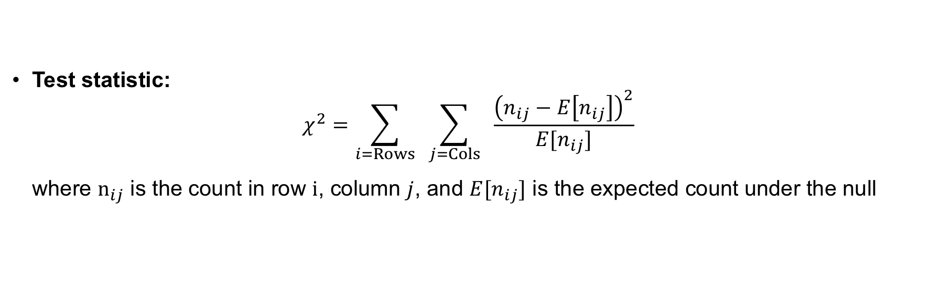
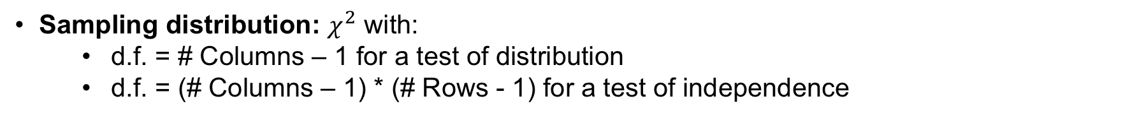

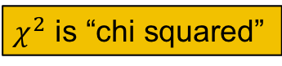
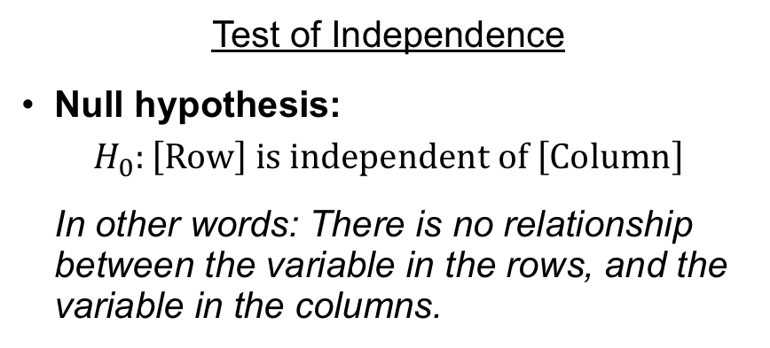
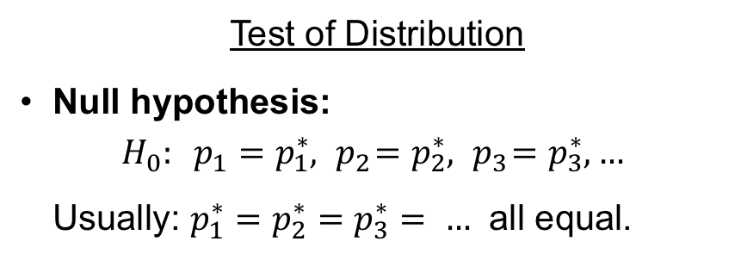
$χ^{2}$ Tests for Tables
$χ^{2}$ is “chi squared”
Test of Distribution
Null hypothesis:
$$H_{0}: p_{1}=p_{1}^{∗}, { p}_{2}=p_{2}^{∗}, { p}_{3}=p_{3}^{∗}, …$$
Usually: $p_{1}^{∗}=p_{2}^{∗}=p_{3}^{∗}= …$ all equal.
Test of Independence
Null hypothesis:
$$H_{0}:\left[Row\right] is independent of \left[Column\right]$$
In other words: There is no relationship between the variable in the rows, and the variable in the columns.
IMPORTANT: The alternative is always “not equal,” even though it’s a one-sided test
Test statistic:
$$χ^{2}=\sum_{i=Rows}{ \sum_{j=Cols}{ \frac{{\left(n_{ij}−E\left[n_{ij}\right]\right)}^{2}}{{E[n}_{ij}]}}}$$
where $n_{ij}$ is the count in row $i$, column $j$, and $E[n_{ij}]$ is the expected count under the null
Warning: Test may be inaccurate if E[n] < 5.
Sampling distribution: $χ^{2}$ with:
d.f. = # Columns – 1 for a test of distribution
d.f. = (# Columns – 1) * (# Rows - 1) for a test of independence

Slide 46
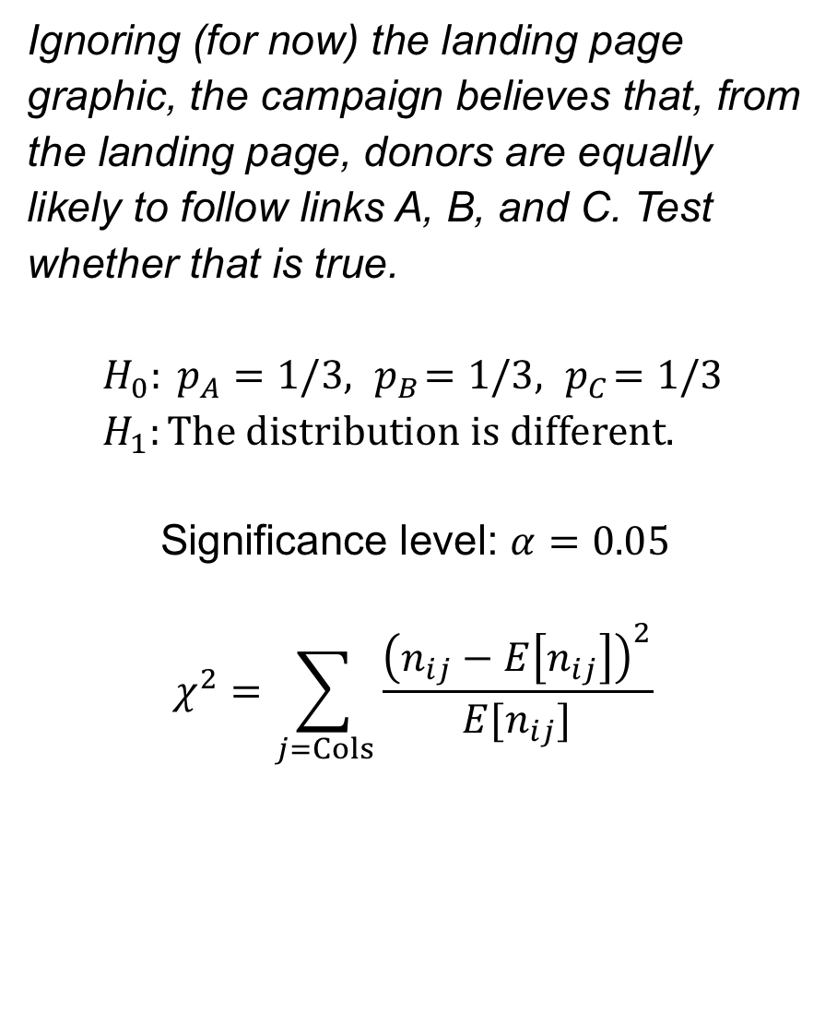
An Experiment on Obama’s Website
Steps to do a hypothesis test
Set the hypotheses, a significance level, and determine the test statistic
Use the data and the null hypothesis to compute the test statistic
Compute the probability of seeing a value more extreme than the test statistic under the sampling distribution (the P-value):
If your alternative is one-sided: take the absolute value of the test statistic and compute the greater than probability
If your alternative is two-sided: multiply the one-sided number by 2.
If P-value < cutoff, reject H₀ in favor of H₁
Ignoring (for now) the landing page graphic, the campaign believes that, from the landing page, donors are equally likely to follow links A, B, and C. Test whether that is true.
$$H_{0}: p_{A}=1/3, { p}_{B}=1/3, { p}_{C}=1/3 \\ H_{1}:The distribution is different.$$
Significance level: $α=0.05$
$$χ^{2}=\sum_{j=Cols}{\frac{{\left(n_{ij}−E\left[n_{ij}\right]\right)}^{2}}{{E[n}_{ij}]}}$$
Notes:
CAN USE PIVOT TABLE TO CREATE COUNTS, OR COUNTIF
WRITE EXPECTED PROBABILITIES
COMPUTE EXPECTED COUNTS
COMPUTE (N-E)^2/E FOR EACH CELL
SUM THEM TO COMPUTE X^2
COMPUTE X-SQ USING 1 – CHISQ.DIST(X^2, 3-1, TRUE)
ALSO SHOW THE CHISQ.TEST COMMAND

Slide 47
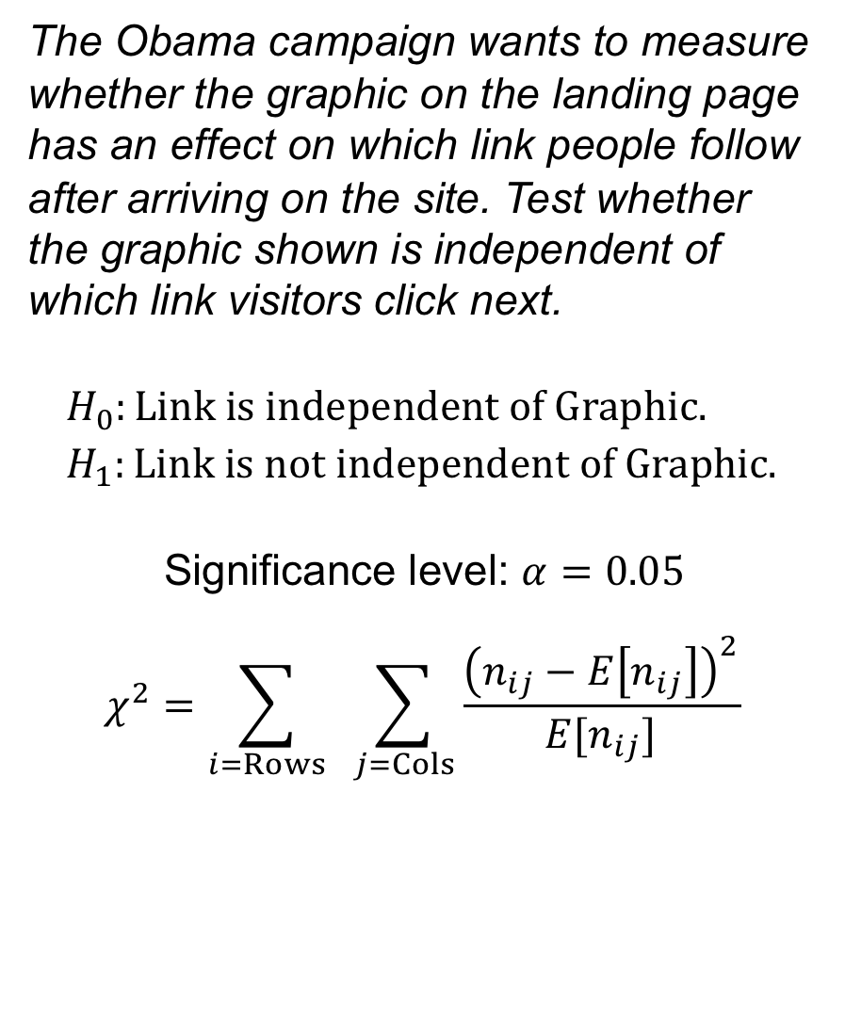
An Experiment on Obama’s Website
Steps to do a hypothesis test
Set the hypotheses, a significance level, and determine the test statistic
Use the data and the null hypothesis to compute the test statistic
Compute the probability of seeing a value more extreme than the test statistic under the sampling distribution (the P-value):
If your alternative is one-sided: take the absolute value of the test statistic and compute the greater than probability
If your alternative is two-sided: multiply the one-sided number by 2.
If P-value < cutoff, reject H₀ in favor of H₁
The Obama campaign wants to measure whether the graphic on the landing page has an effect on which link people follow after arriving on the site. Test whether the graphic shown is independent of which link visitors click next.
$$H_{0}:Link is independent of Graphic. \\ H_{1}:Link is not independent of Graphic.$$
Significance level: $α=0.05$
$$χ^{2}=\sum_{i=Rows}{ \sum_{j=Cols}{\frac{{\left(n_{ij}−E\left[n_{ij}\right]\right)}^{2}}{{E[n}_{ij}]}}}$$
Notes:
USE PIVOT TABLE TO CREATE COUNTS
COMPUTE EXPECTED COUNTS (CAN HELP TO FIX COL/ROW REFERENCES)
COMPUTE (N-E)^2/E FOR EACH CELL
SUM THEM TO COMPUTE X^2
COMPUTE X-SQ USING 1 – CHISQ.DIST(X^2, 3-1, TRUE)
ALSO SHOW THE CHISQ.TEST COMMAND

Slide 48
Recap: Taxonomy of Tests
Outcome Type
 | Means Numeric Outcome (Interval / Ratio) | Proportions Binary Outcome (Yes/No) | Distributions Categorical Outcome (Nominal / Ordinal)
One-sample Testing if the truth is different from some hypothesized value | Is the true mean value of X equal to my hypothesized value? One-sample t-test for means | Is the true proportion of “successes” equal to my hypothesized value? One-sample z-test for proportions | Are the true probabilities of each outcome equal to my hypothesized values? Chi-squared test for distribution
Two-sample Testing if two groups are different | Is the mean of X for group A equal to the mean of X for group B? Two-sample t-test for means | Is the proportion of “successes” the same in groups A and B? Two-sample z-test for proportions | Does the distribution of X depend on the value of Y? Chi-squared test for independence
Question Type

Slide 49
Misuses and Pitfalls

Slide 50
One- vs. Two-sided Tests
“One-sided tests are a two-edged sword”
One-sided tests give more power to detect an effect in that direction
…but they cannot detect any effects in the other direction
Think about the consequences: does the other side matter too?

Slide 51
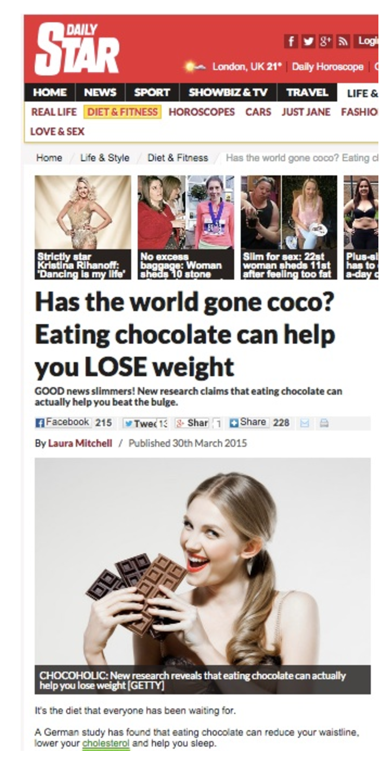
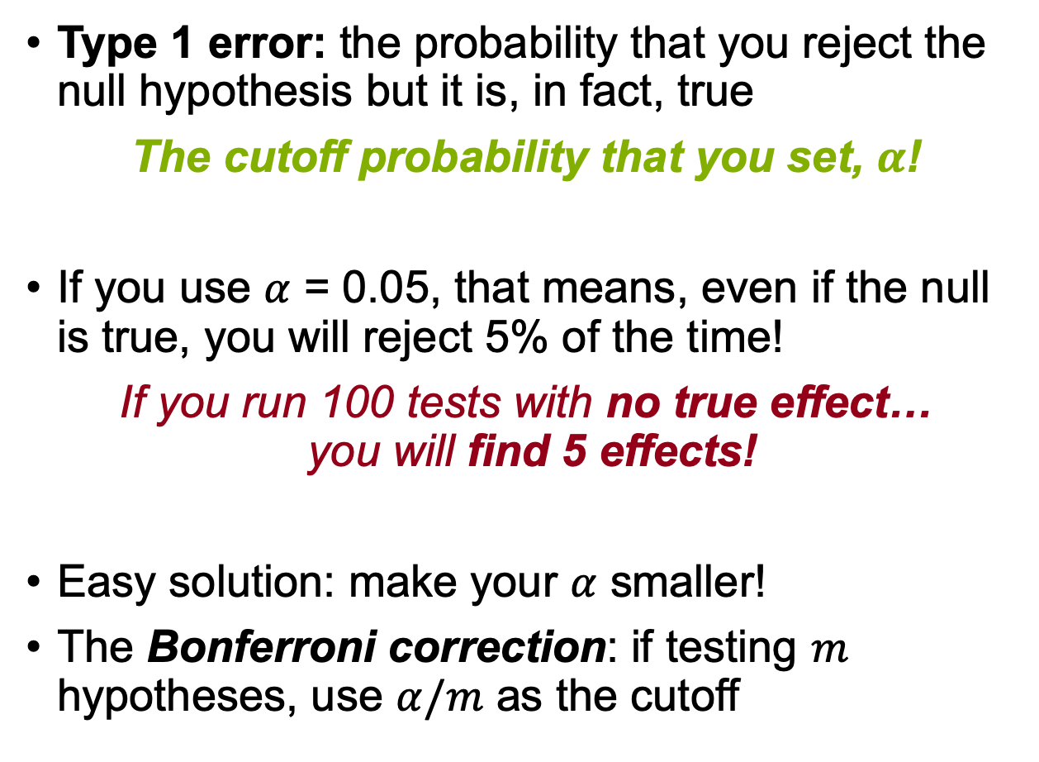
Multiple Comparisons
Type 1 error: the probability that you reject the null hypothesis but it is, in fact, true
The cutoff probability that you set, $α$!
If you use $α$ = 0.05, that means, even if the null is true, you will reject 5% of the time!
If you run 100 tests with no true effect… you will find 5 effects!
Easy solution: make your $α$ smaller!
The Bonferroni correction: if testing $m$ hypotheses, use $α/m$ as the cutoff

Slide 52
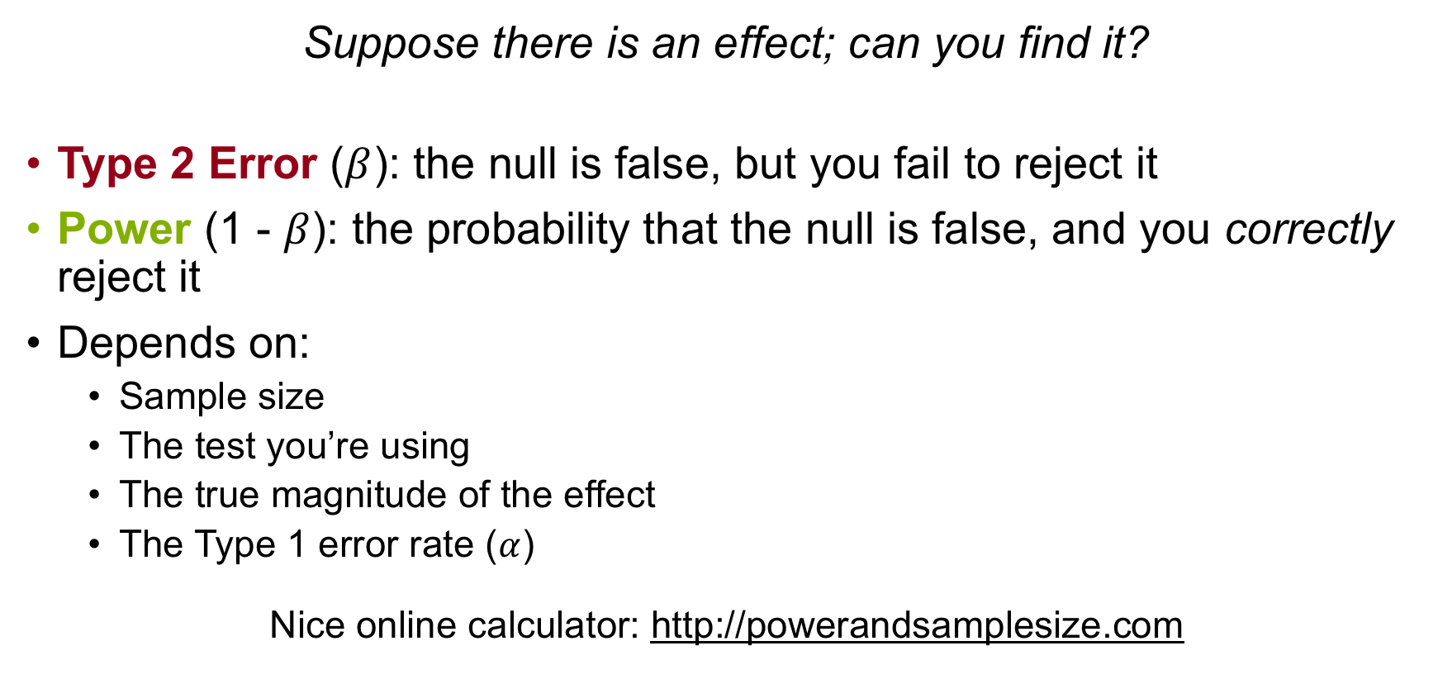
Power
Suppose there is an effect; can you find it?
Type 2 Error ($β$): the null is false, but you fail to reject it
Power (1 - $β$): the probability that the null is false, and you correctly reject it
Depends on:
Sample size
The test you’re using
The true magnitude of the effect
The Type 1 error rate ($α$)
Nice online calculator: http://powerandsamplesize.com

Slide 53
Hypothesis Tests in A/B Testing
Important things to watch for
One vs. two-sided tests
Regression to the mean
Novelty effects
Basically: Run multiple tests, for a long time

Slide 54
Takeaways
Hypothesis tests use the idea of sampling variability to test whether a null hypothesis is not true
You should know:
What test to use (we’ll cover the last one next class)
How to form a null/alternative hypothesis
How to use Excel (or R) to carry out a test
How to interpret the results
There are many pitfalls: be aware of one vs. two-sided tests, multiple comparisons, and power
Next two classes: Regression

